Slide 1

Machine Learning K-Means Clustering
By K. Igwe 2021

Slide 2
Lesson Objectives
Introduction to Clustering
History of Clustering
Clustering Techniques
K-Means Clustering
Examples and Exercises

Slide 3
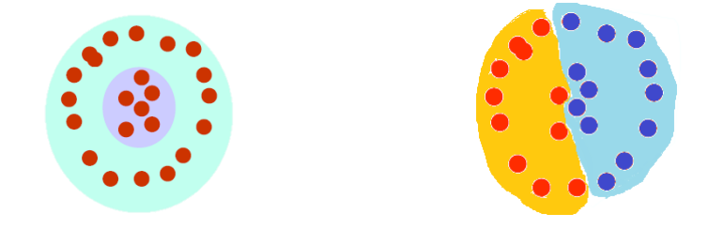
Introduction
The organization/segmentation of unlabeled data into similarity groups called clusters.
A cluster is a collection of data items which are “similar” between them, and “dissimilar” to data items in other clusters.

Slide 4
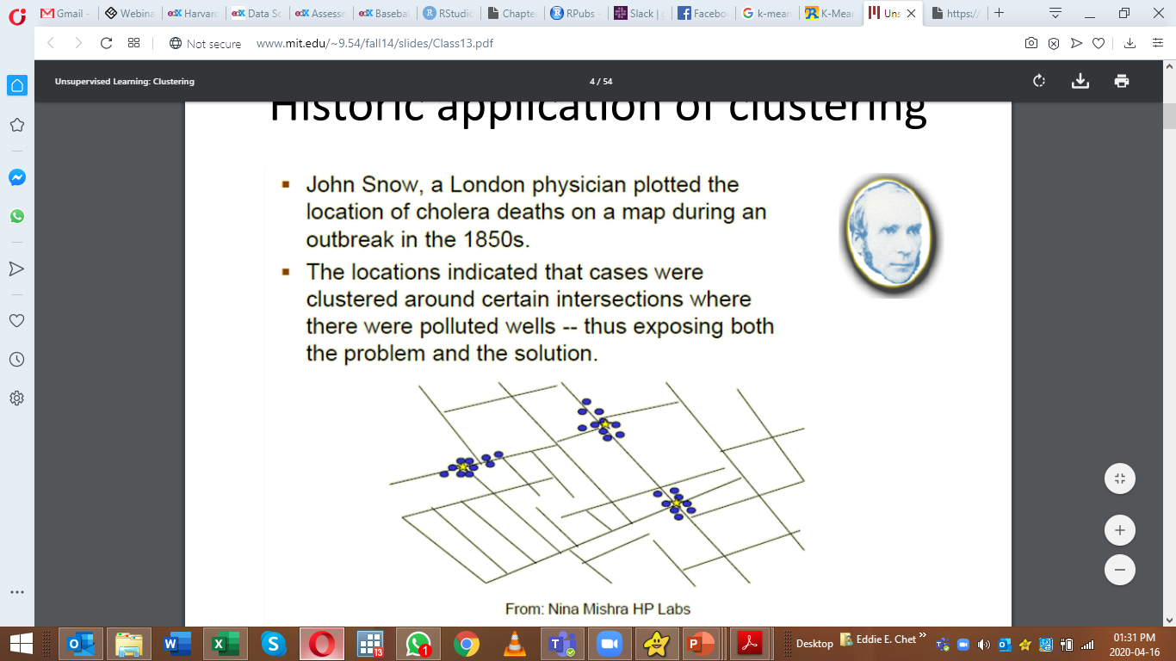
Historical Application of Clustering
John Snow, a London physician plotted location of cholera deaths on a map during an outbreak in 1850s.
Locations indicated that cases were clustered around certain intersections where there were polluted wells;
thus exposing both the problem and the solution.

Slide 5
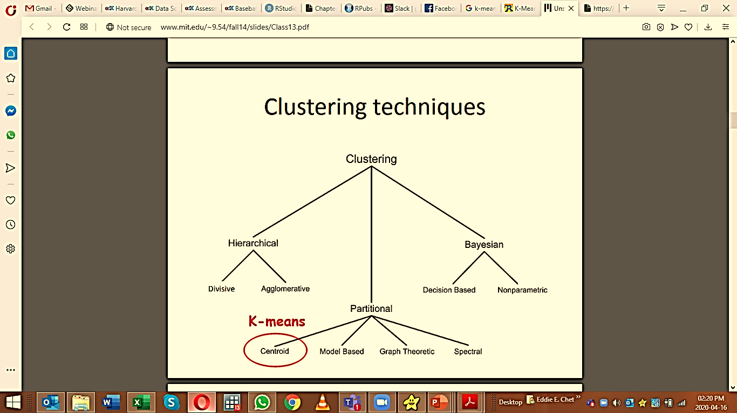
What do we need for Clustering?
Required:
Proximity measure.
Criterion function to evaluate a clustering.
Algorithm to compute clustering.

Slide 6
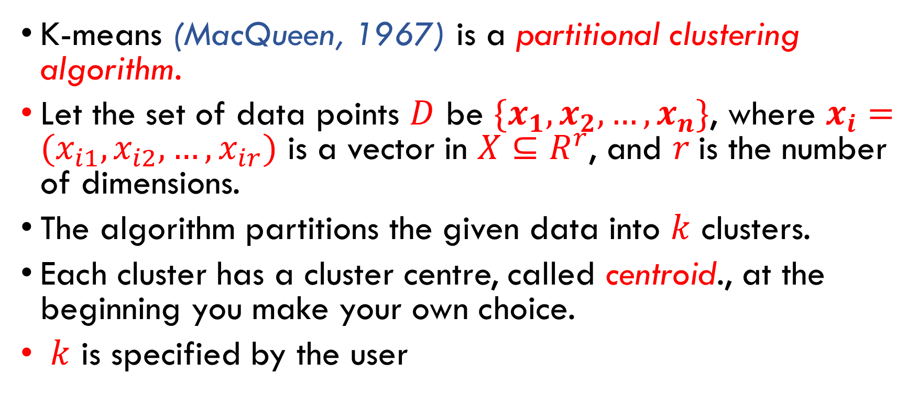
K-Means Clustering
K-means (MacQueen, 1967) is a partitional clustering algorithm.
Let the set of data points $D$ be $\{x_{1},x_{2},…,x_{n}\}$, where $x_{i}=(x_{i1},x_{i2},…,x_{ir})$ is a vector in $X⊆R^{r}$, and $r$is the number of dimensions.
The algorithm partitions the given data into $k$ clusters.
Each cluster has a cluster centre, called centroid., at the beginning you make your own choice.
$k$ is specified by the user

Slide 7
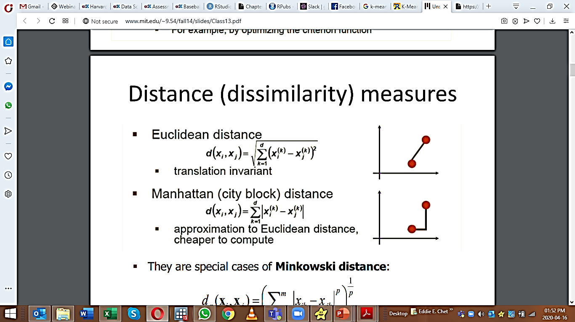
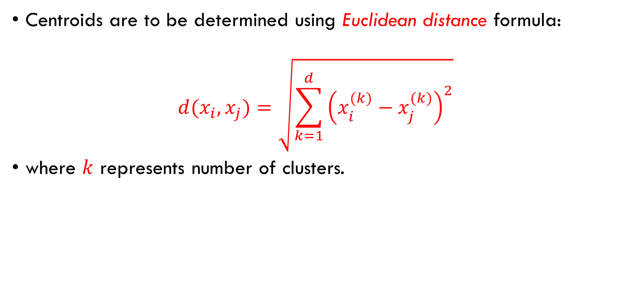
Determining Centroids
Centroids are to be determined using Euclidean distance formula:
$$d(x_{i},x_{j})=\sqrt{\sum_{k=1}^{d}{{\left(x_{i}^{(k)}−x_{j}^{(k)}\right)}^{2}}}$$
where $k$ represents number of clusters.

Slide 8
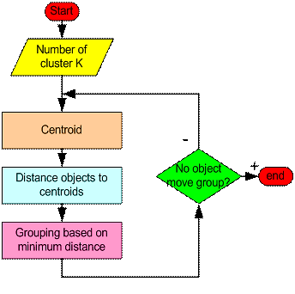
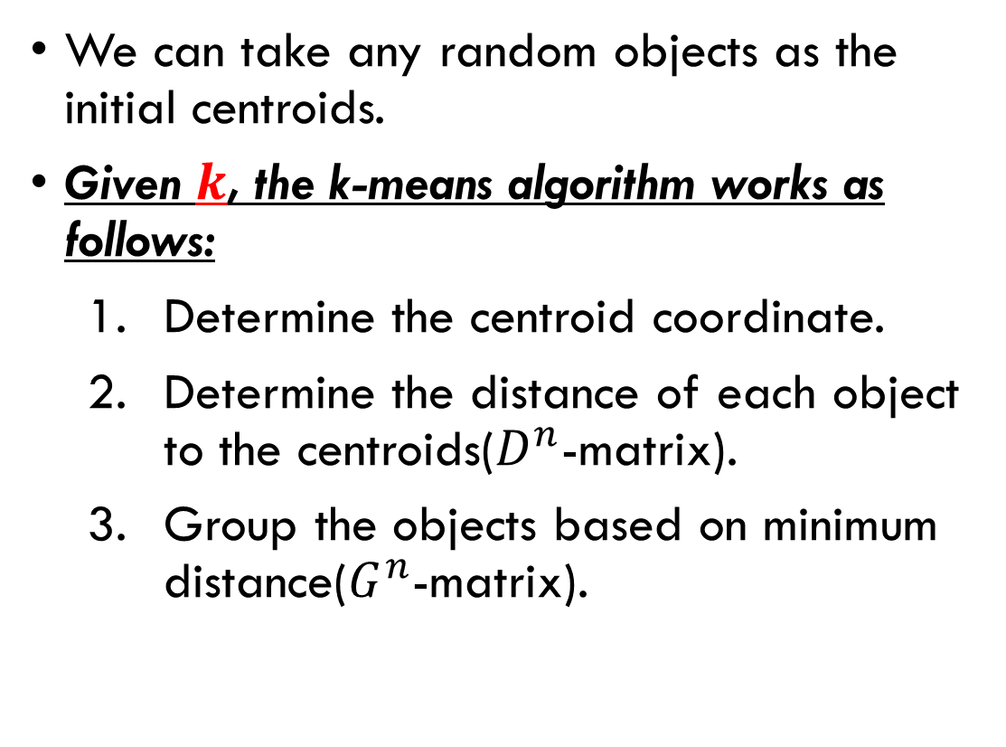
K-means Algorithm
We can take any random objects as the initial centroids.
Given $k$, the k-means algorithm works as follows:
Determine the centroid coordinate.
Determine the distance of each object to the centroids($D^{n}$-matrix).
Group the objects based on minimum distance($G^{n}$-matrix).

Slide 9
K-means Algorithm Example
Suppose we have 4 objects as your training data point and each object have 2 attributes.
Each attribute represents coordinate of the object.
Thus, we also know before hand that these objects belong to two groups of medicine (cluster 1 and cluster 2).
Q: Determine which medicines belong to cluster 1 and which medicines belong to the other cluster?
Each medicine represents one point with two components coordinate as shown below.
Object | Attribute 1: Weight index | Attribute 2: pH
Medicine A | 1 | 1
Medicine B | 2 | 1
Medicine C | 4 | 3
Medicine D | 5 | 4

Slide 10
K-means Algorithm Example
Suppose we have 4 objects as your training data point and each object have 2 attributes.
Each attribute represents coordinate of the object.
Thus, we also know before hand that these objects belong to two groups of medicine (cluster 1 and cluster 2).
Q: Determine which medicines belong to cluster 1 and which medicines belong to the other cluster?
Each medicine represents one point with two components coordinate as shown below.
Object | Attribute 1: Weight index | Attribute 2: pH
Medicine A | 1 | 1
Medicine B | 2 | 1
Medicine C | 4 | 3
Medicine D | 5 | 4

Slide 11
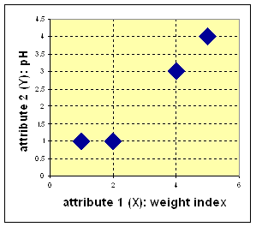
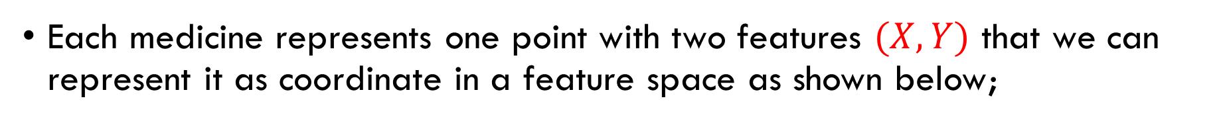
Solution
Each medicine represents one point with two features $(X,Y)$ that we can represent it as coordinate in a feature space as shown below;

Slide 12
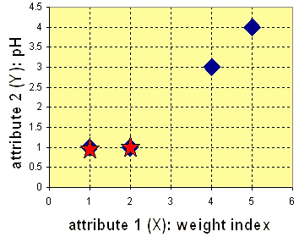
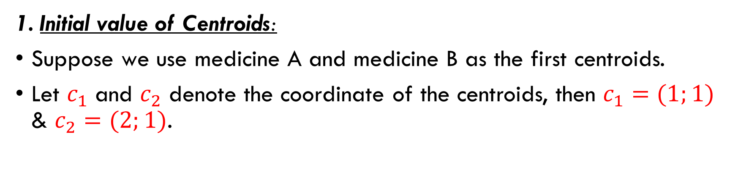
Iteration-0
1. Initial value of Centroids:
Suppose we use medicine A and medicine B as the first centroids.
Let $c_{1}$ and $c_{2}$ denote the coordinate of the centroids, then $c_{1}=(1;1)$ & $c_{2}=(2;1)$.

Slide 13
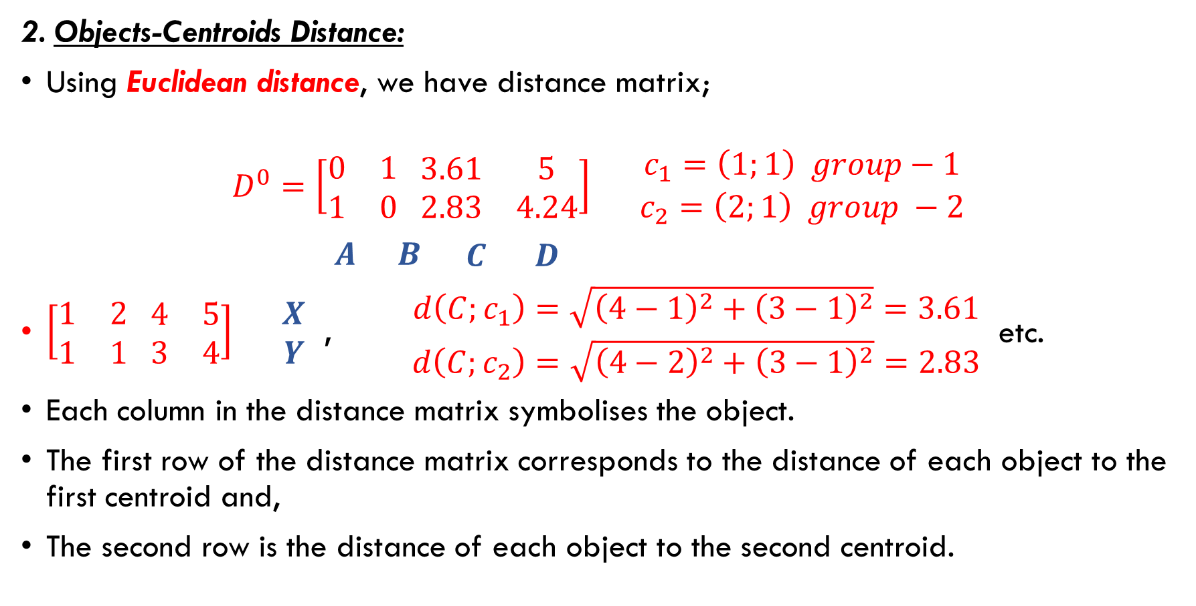
Iteration-0 (Continued)
2. Objects-Centroids Distance:
Using Euclidean distance, we have distance matrix;
$$D^{0}=\left[\begin{matrix}0 & 1 \\ 1 & 0\end{matrix} \begin{matrix}3.61 & 5 \\ 2.83 & 4.24\end{matrix}\right] \begin{matrix}c_{1}=\left(1;1\right) group−1 \\ c_{2}=\left(2;1\right) group −2\end{matrix}$$
$\begin{matrix}A & B \begin{matrix}C & D\end{matrix}\end{matrix}$
$\left[\begin{matrix}1 & 2 \\ 1 & 1\end{matrix} \begin{matrix}4 & 5 \\ 3 & 4\end{matrix}\right] \begin{matrix}X \\ Y\end{matrix}$ , $\begin{matrix}d\left(C;c_{1}\right)=\sqrt{{\left(4−1\right)}^{2}+{\left(3−1\right)}^{2}}=3.61 \\ d\left(C;c_{2}\right)=\sqrt{{\left(4−2\right)}^{2}+{\left(3−1\right)}^{2}}=2.83\end{matrix}$ etc.
Each column in the distance matrix symbolises the object.
The first row of the distance matrix corresponds to the distance of each object to the first centroid and,
The second row is the distance of each object to the second centroid.

Slide 14
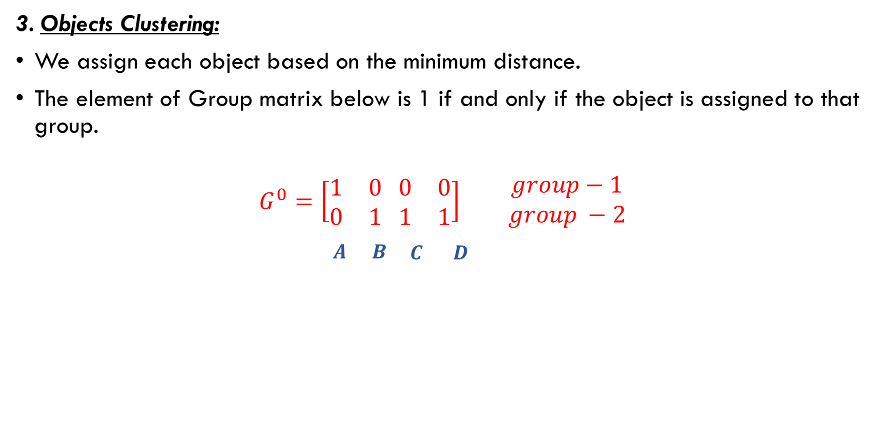
Iteration-0 (Continued)
3. Objects Clustering:
We assign each object based on the minimum distance.
The element of Group matrix below is 1 if and only if the object is assigned to that group.
$$G^{0}=\left[\begin{matrix}1 & 0 \\ 0 & 1\end{matrix} \begin{matrix}0 & 0 \\ 1 & 1\end{matrix}\right] \begin{matrix} group−1 \\ group −2\end{matrix}$$
$\begin{matrix}A & B \begin{matrix}C & D\end{matrix}\end{matrix}$

Slide 15
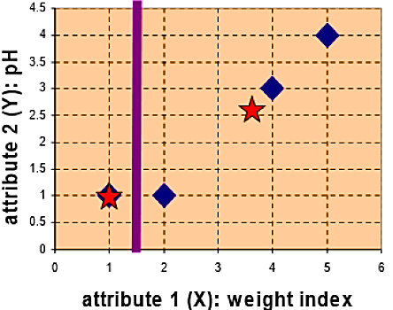
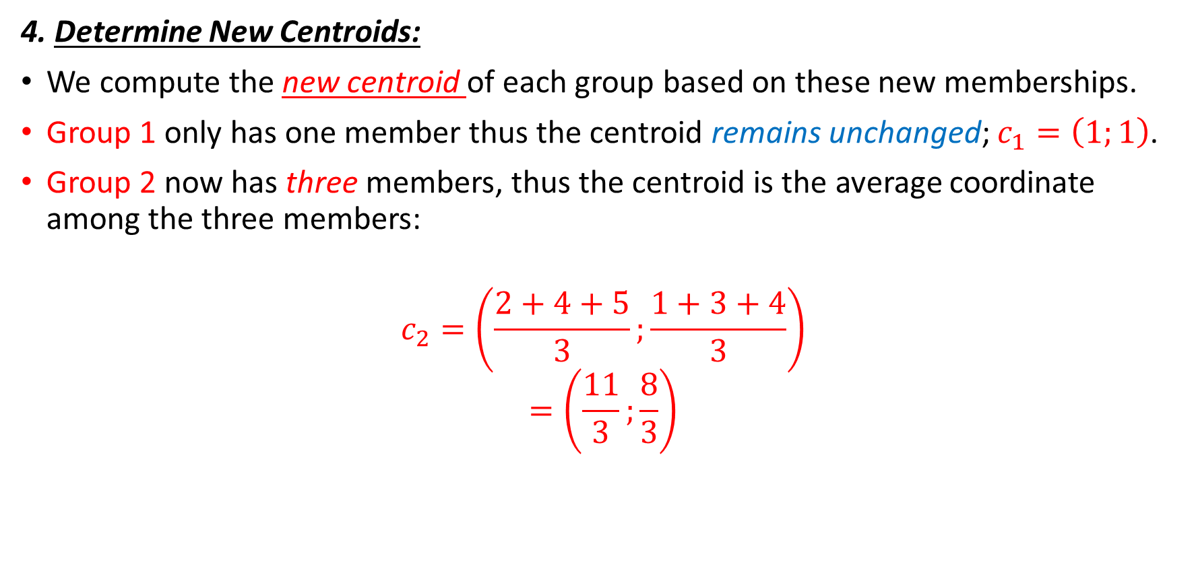
Iteration-1
4. Determine New Centroids:
We compute the new centroid of each group based on these new memberships.
Group 1 only has one member thus the centroid remains unchanged; $c_{1}=\left(1;1\right)$.
Group 2 now has three members, thus the centroid is the average coordinate among the three members:
$$c_{2}=\left(\frac{2+4+5}{3};\frac{1+3+4}{3}\right)$$
$$=\left(\frac{11}{3};\frac{8}{3}\right)$$

Slide 16
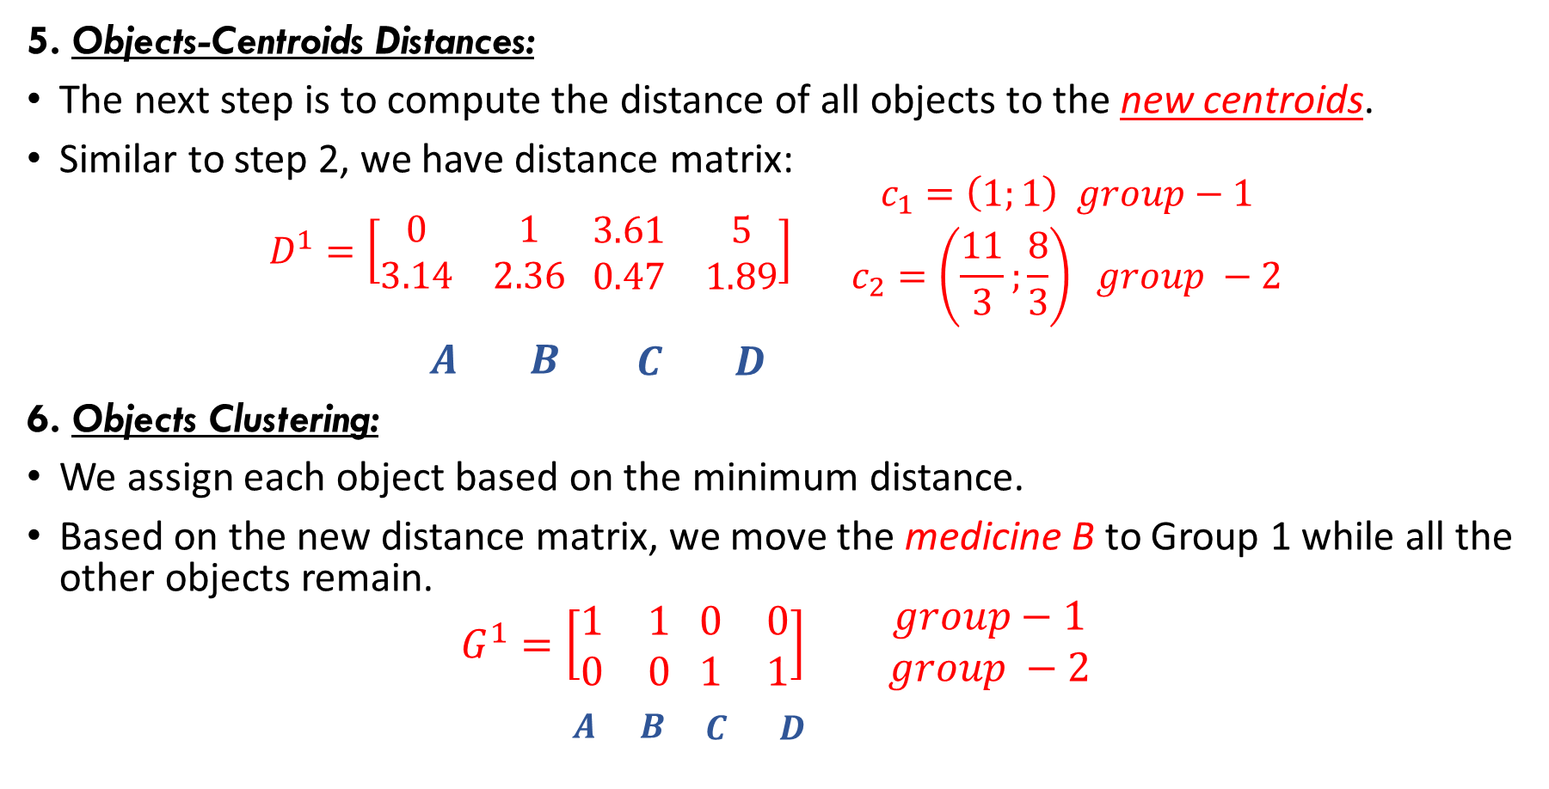
Iteration-1 (Continued)
5. Objects-Centroids Distances:
The next step is to compute the distance of all objects to the new centroids.
Similar to step 2, we have distance matrix:
$$D^{1}=\left[\begin{matrix}0 & 1 \\ 3.14 & 2.36\end{matrix} \begin{matrix}3.61 & 5 \\ 0.47 & 1.89\end{matrix}\right] \begin{matrix}c_{1}=\left(1;1\right) group−1 \\ c_{2}=\left(\frac{11}{3};\frac{8}{3}\right) group −2\end{matrix}$$
$\begin{matrix}A & B \begin{matrix}C & D\end{matrix}\end{matrix}$
6. Objects Clustering:
We assign each object based on the minimum distance.
Based on the new distance matrix, we move the medicine B to Group 1 while all the other objects remain.
$$G^{1}=\left[\begin{matrix}1 & 1 \\ 0 & 0\end{matrix} \begin{matrix}0 & 0 \\ 1 & 1\end{matrix}\right] \begin{matrix} group−1 \\ group −2\end{matrix}$$
$\begin{matrix}A & B \begin{matrix}C & D\end{matrix}\end{matrix}$

Slide 17
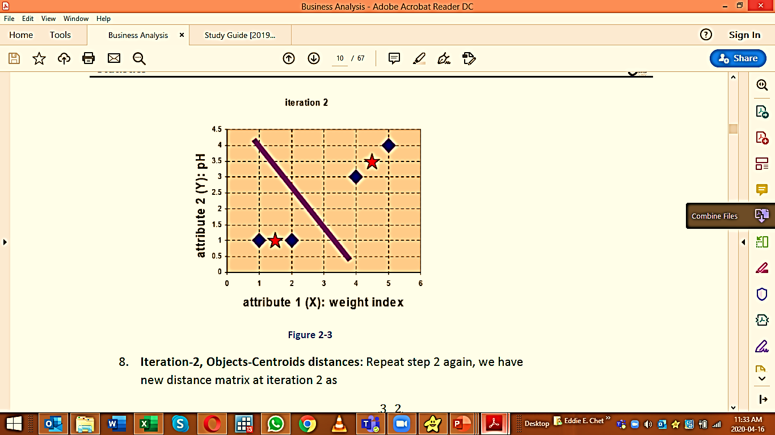
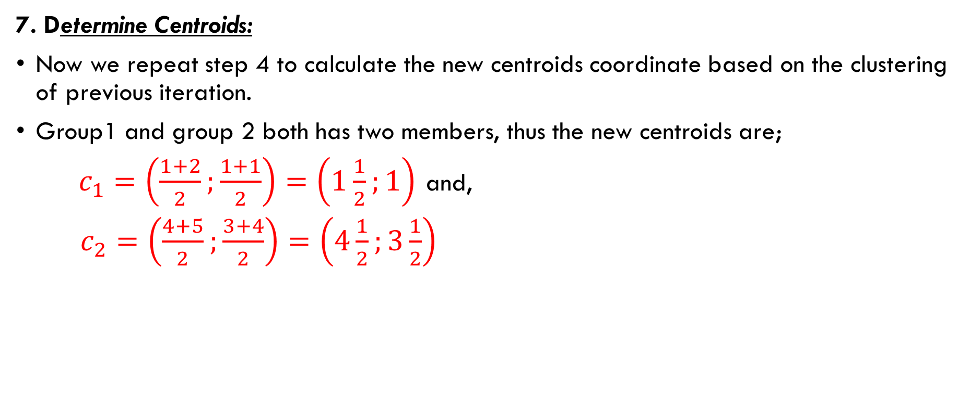
Iteration-2
7. Determine Centroids:
Now we repeat step 4 to calculate the new centroids coordinate based on the clustering of previous iteration.
Group1 and group 2 both has two members, thus the new centroids are;
$c_{1}=\left(\frac{1+2}{2};\frac{1+1}{2}\right)=\left(1\frac{1}{2};1\right)$ and,
$c_{2}=\left(\frac{4+5}{2};\frac{3+4}{2}\right)=\left(4\frac{1}{2};3\frac{1}{2}\right)$

Slide 18
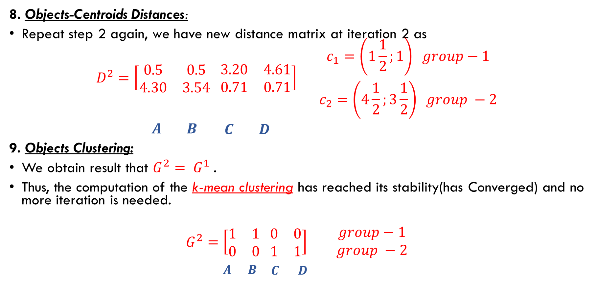
Iteration-2 (Continued)
8. Objects-Centroids Distances:
Repeat step 2 again, we have new distance matrix at iteration 2 as
$$D^{2}=\left[\begin{matrix}0.5 & 0.5 \\ 4.30 & 3.54\end{matrix} \begin{matrix}3.20 & 4.61 \\ 0.71 & 0.71\end{matrix}\right] \begin{matrix}c_{1}=\left(1\frac{1}{2};1\right) group−1 \\ c_{2}=\left(4\frac{1}{2};3\frac{1}{2}\right) group −2\end{matrix}$$
$\begin{matrix}A & B \begin{matrix}C & D\end{matrix}\end{matrix}$
9. Objects Clustering:
We obtain result that $G^{2}= G^{1}$.
Thus, the computation of the k-mean clustering has reached its stability(has Converged) and no more iteration is needed.
$$G^{2}=\left[\begin{matrix}1 & 1 \\ 0 & 0\end{matrix} \begin{matrix}0 & 0 \\ 1 & 1\end{matrix}\right] \begin{matrix} group−1 \\ group −2\end{matrix}$$
$\begin{matrix}A & B \begin{matrix}C & D\end{matrix}\end{matrix}$

Slide 19
Final Result:
We get the final grouping as the results;
Group 1: Medicine A and B
Group 2: Medicine C and D.
Object | Feature 1: Weight index | Feature 2: pH | Group (Results)
Medicine A | 1 | 1 | 1
Medicine B | 2 | 1 | 1
Medicine C | 4 | 3 | 2
Medicine D | 5 | 4 | 2

